Slide 1
At the Chinese Restaurant
Phrases for Listening & Speaking:
Review the phrases ,which students have learned previously, related to the topic.
Objective: students will be able to use the phrases in context. (Listening, speaking, read and write pinyin)

Slide 2
Procedure
1. Teacher show the slides. Ask students to identify items on the slides and practice saying all the phrases in Chinese.
Activity 1:According to the nature of each slide, teacher may ask the following questions:
  這是什麼？
  你喜歡吃/喝 （food item） 嗎？
  哪裏有item？（Place） 有沒有（item）?
  （object）在哪裏？
  (food item) 酸/甜/辣 不 酸/甜/辣？
  (food item1)酸/甜/辣還是(food item2)酸/甜/辣？
Activity 2: (continue on next page)

Slide 3
Activity 2:Put the phrases you learned into the following categories.
  Places:
  Solid foods:
  Drinks:
  Flavors:
  Flavor enhancer:
  Others
Homework (presentational)
Write a short paragraph (in pinyin) talking about your dinner using phrases you learned today. Include as many phrases as you can. (Rubric: see writing rubric for Novice – mid)

Slide 4
飯，餓，茶，菜 (flashcard)
飯 | 餓
茶 | 菜

Slide 5
飯，餓，茶，菜 (PPT for class)
飯 | 餓
茶 | 菜

Slide 6
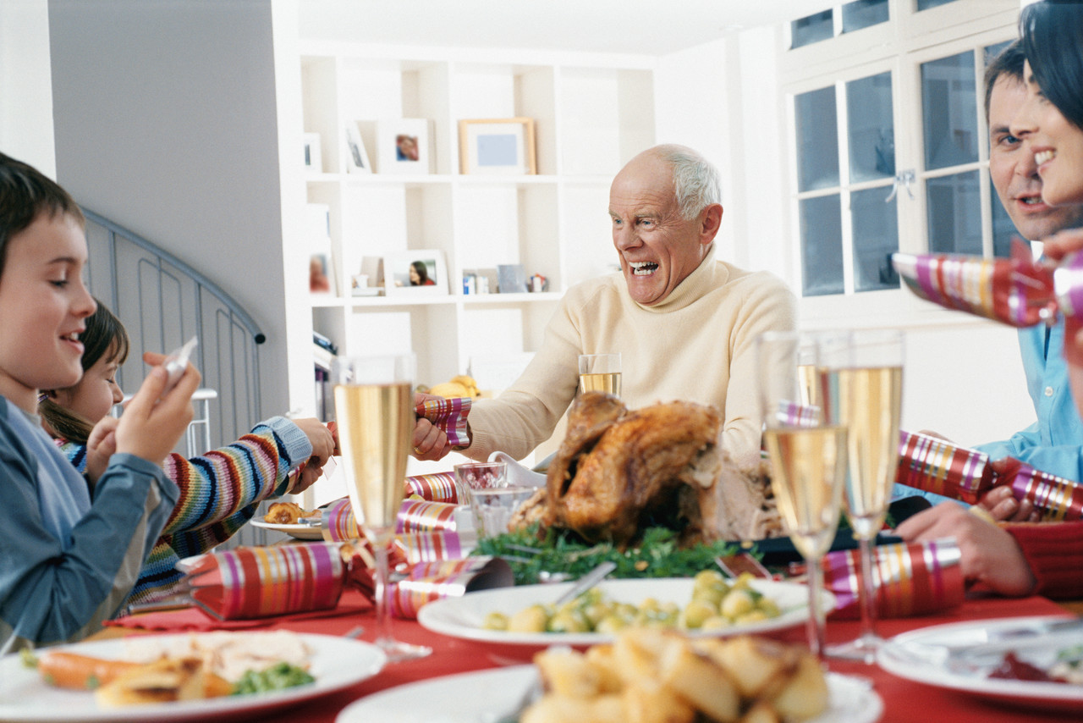
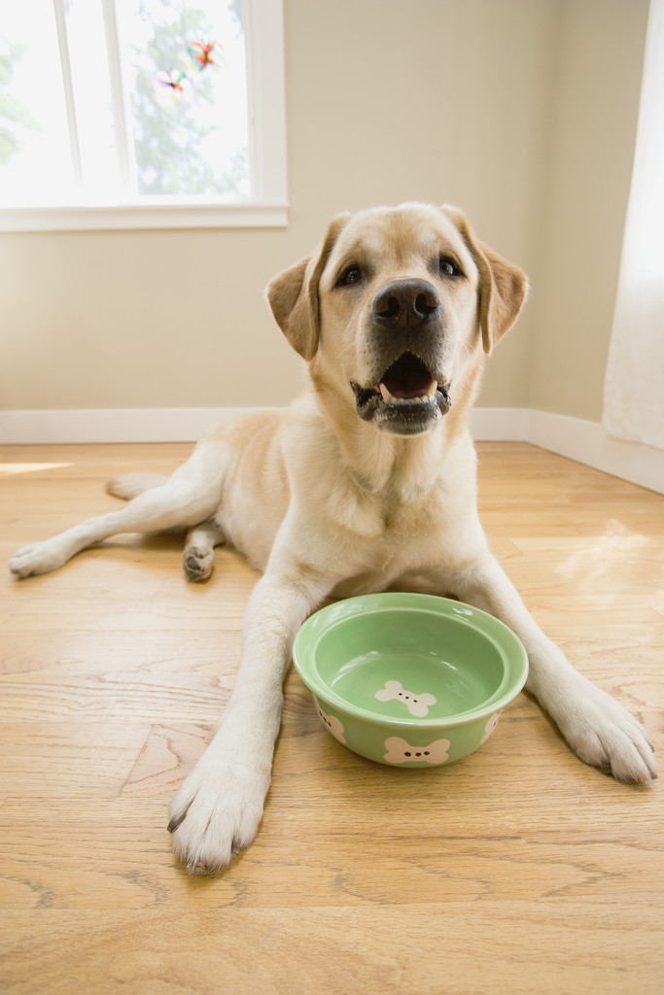
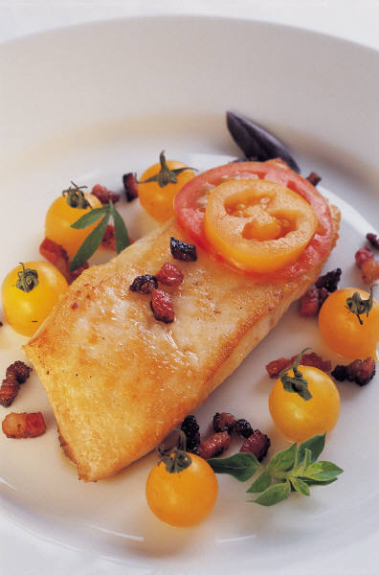
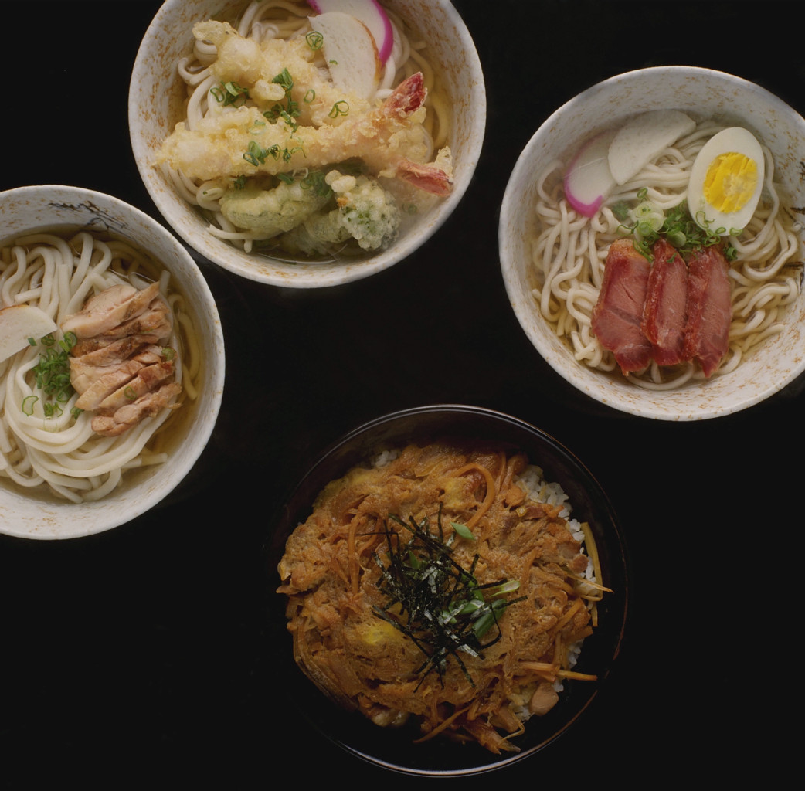
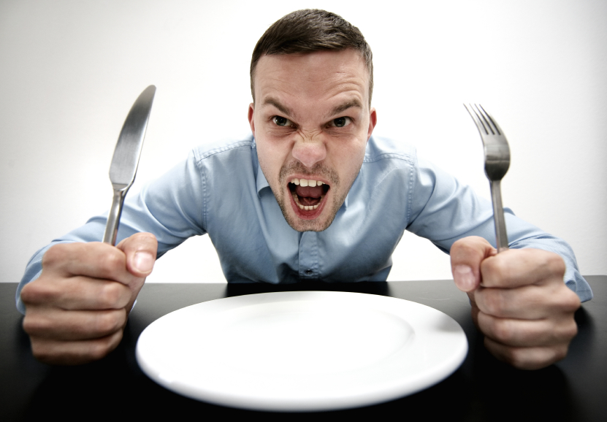
Elaborate as much as you can with the targeted characters
飯 | 餓
Images from Microsoft Office Clipart

Slide 7
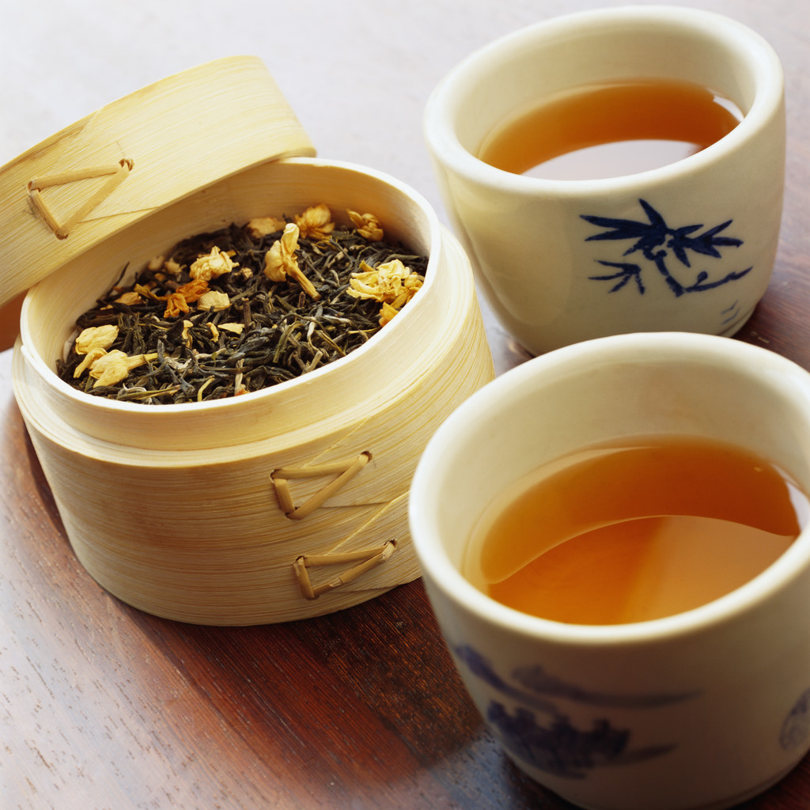
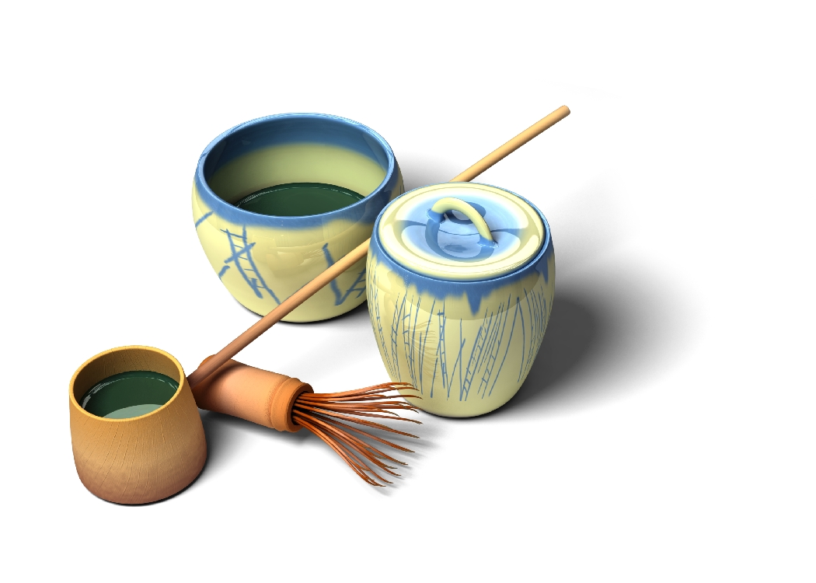
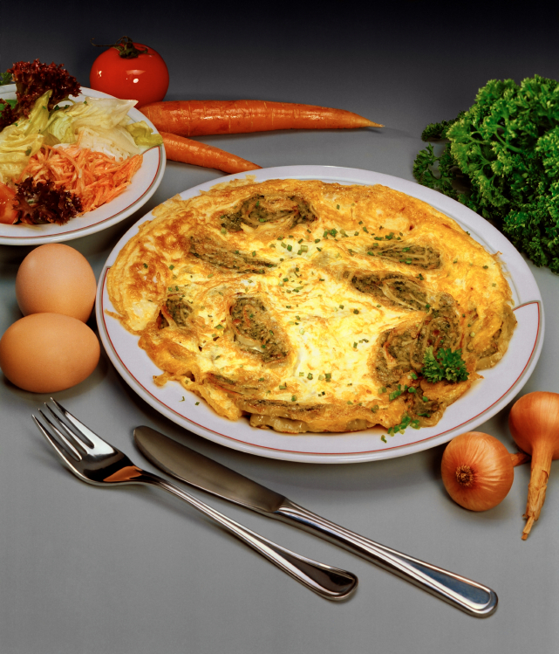
Elaborate as much as you can with the targeted characters
茶 | 菜
Images from Microsoft Office Clipart

Slide 8
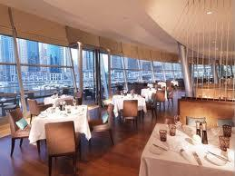
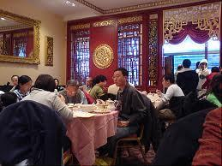
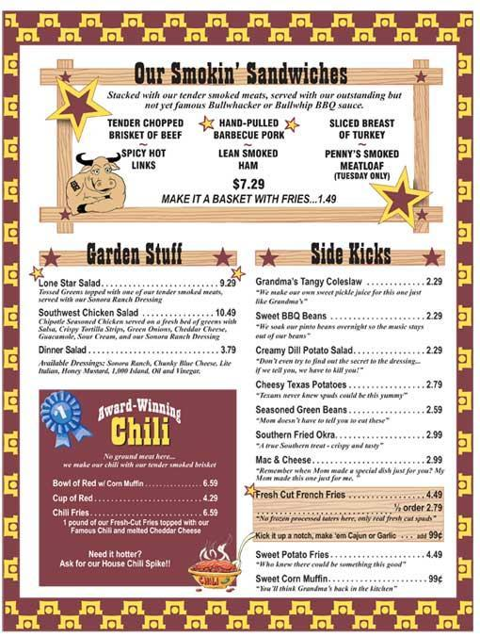
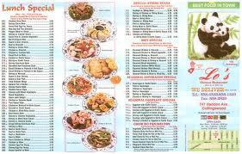
fànguǎn
飯
càidān
菜
Notes:
飯館，菜單，

Slide 9
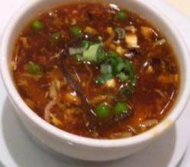
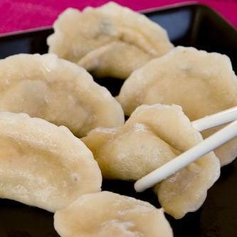
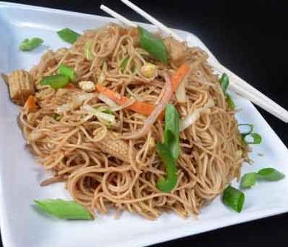
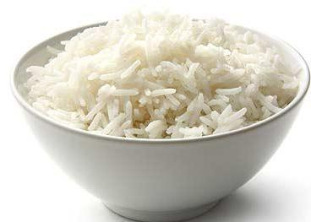
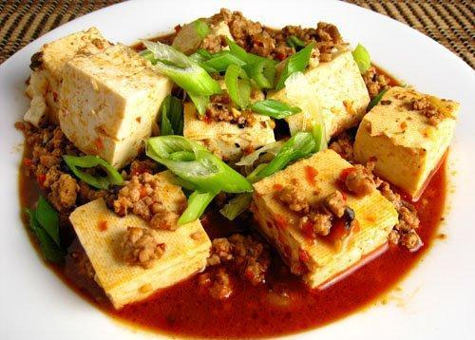
suānlà湯
jiǎozi
miàn
mǐ飯
dòufu
Notes:
酸辣湯，餃子，麵，米飯，豆腐，

Slide 10
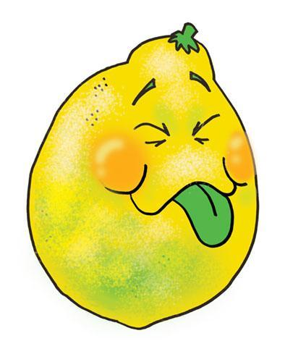


suān là tián
Notes:
酸，辣，甜，

Slide 11


hóng茶
Lǜ茶
Notes:
紅茶，綠茶

Slide 12
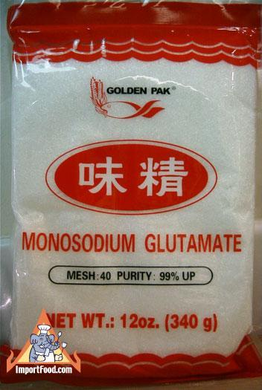
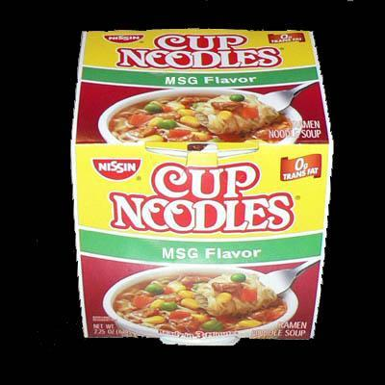
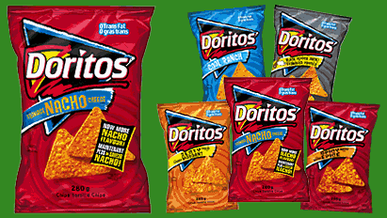
wèijīng
Notes:
味精，

Slide 13

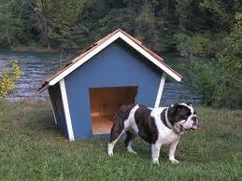
lǐmian
wàimian
Notes:
裏面，外面，

